Slide 1
Midway Design Review
Team QuickTab
December 8, 2016
Notes:
‹#›
‹#›
‹#›
‹#›

Slide 2
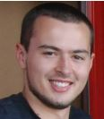
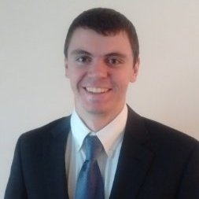
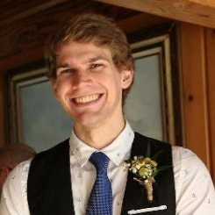
QuickTab (Intuitive Tablature Generation)
Joe Biegaj
EE
Lindsay Manning
EE
John Bonk
EE
Jacob Prescott
EE
Notes:
‹#›
‹#›
‹#›
‹#›

Slide 3
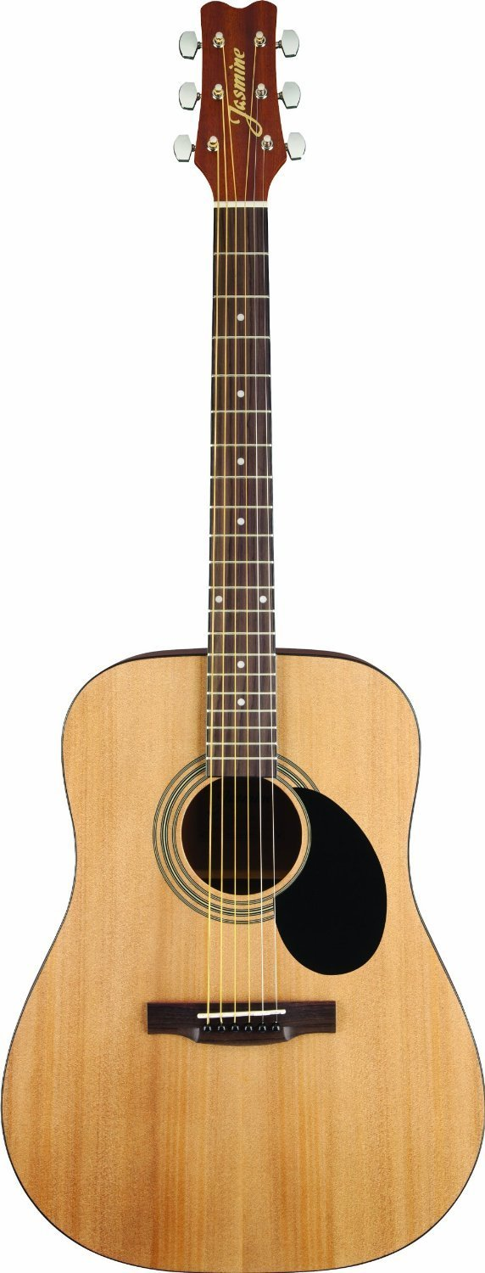
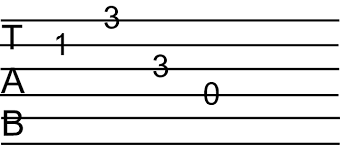
QuickTab

Slide 4
Updated System Requirements
Sensors
Accelerometer will be able to detect notes played within 250 ms of each other (240 BPM)
By taking FFTs of the output data, MATLAB will be able to determine the frequencies played and at what time
Six vibration sensors will work in coordination with the accelerometer to determine the correct string and fret
Python/MATLAB/Tab Compiler
Python code should be able to receive data from ADXL345, vibration sensors, and handle button interrupts
This data will be written to a file and transmitted via USB or SD Card onto personal computer for processing using MATLAB
MATLAB will be able to determine frequencies and therefore frets played on the guitar
The Tab Compiler will take both sets of data and print out the tablature onto a tablature music sheet template
User Interface
Easy-to-use UI with Start/Stop, Calibration, and Power buttons
Notes:
‹#›
‹#›
‹#›
‹#›

Slide 5
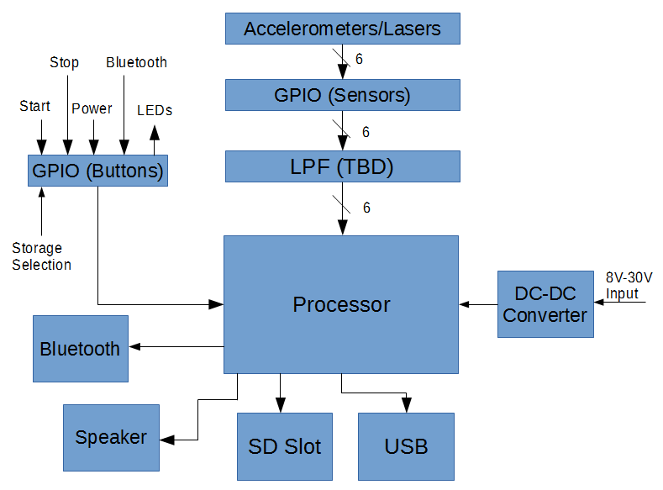
Old Block Diagram
Notes:
‹#›
‹#›
‹#›
‹#›
Lemon costs $1 (Good point)

Slide 6
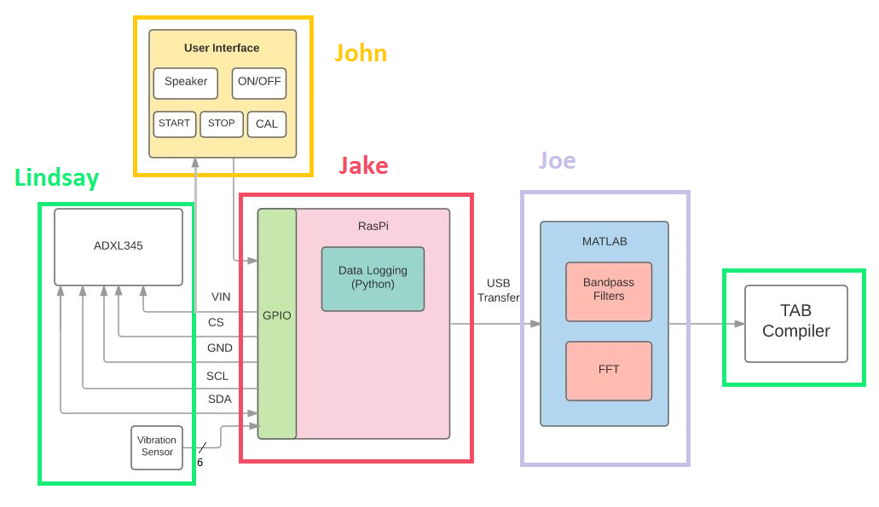
Revised Block Diagram
Notes:
‹#›
‹#›
‹#›
‹#›
Lemon costs $1 (Good point)

Slide 7
Proposed MDR Deliverables
Identify 10 notes played on a single string with 90% accuracy
10 notes will ensure that we can monitor note accuracy and can be used as our test as we incorporate additional strings
Identifying these notes will provide evidence not only of correct sensory input but also of the accurate interpretation of signals by our algorithm
Verify that latency is sufficiently low so that we can record notes and rhythms within 100 ms of them being played
We do not anticipate more than 4 notes occurring in a single second, but maintaining accuracy of this magnitude will allow us to precisely and accurately replicate the rhythms we record
Notes:
‹#›
‹#›
‹#›
‹#›

Slide 8
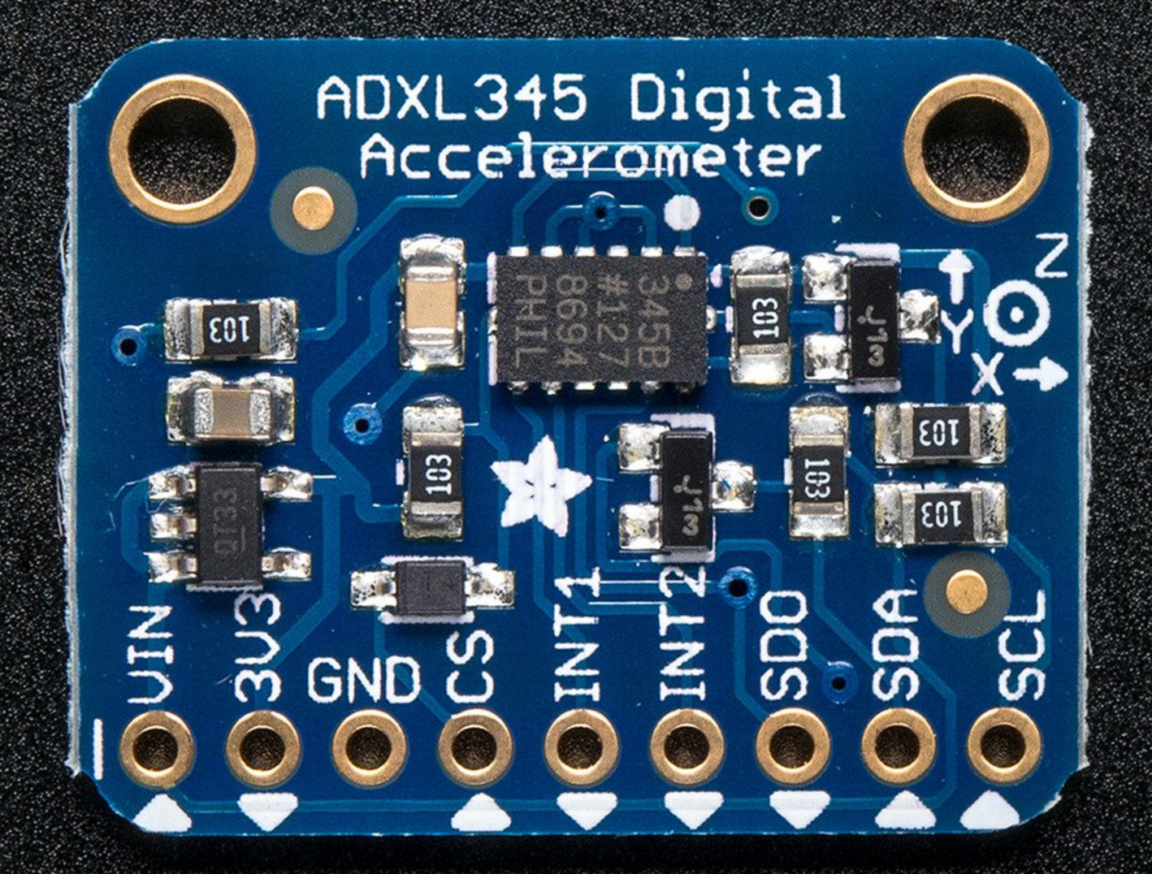
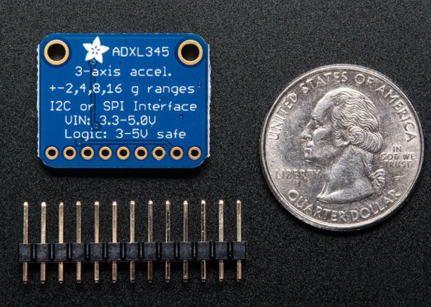
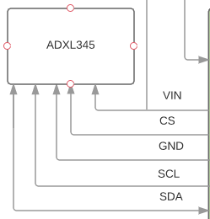
Accelerometer Features
ADXL345 by Analog Devices
Small, 3mm x 5mm x 1mm that fits on the bridge of the guitar
3-axis accelerometer with high resolution measurement with digital output data
I²C or SPI connection types available
Variable data transfer rate, 6.25Hz - 3200 Hz
FIFO technology to minimize host processor load
32-level FIFO that will store data to be read via interrupt or by user convenience
Low power, 3.3V input and 40µA in measurement mode and 1µA in standby
Notes:
‹#›
‹#›
‹#›
‹#›

Slide 9
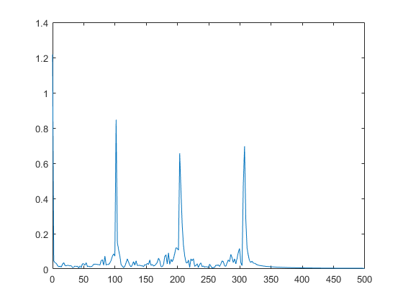
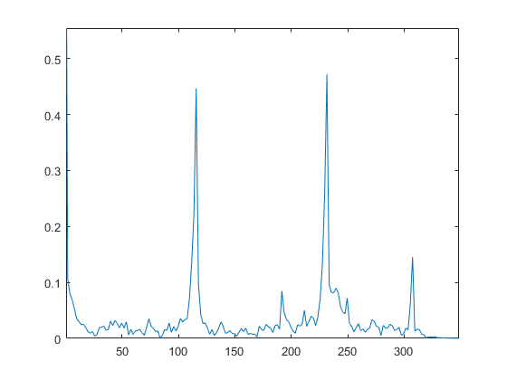
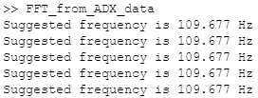
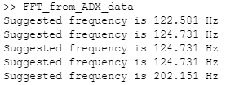
Accelerometer Results Continued (A2,B2)
Using small time windows we can accurately find the frequency played all the down the length of the A string.
110Hz
123Hz
Notes:
‹#›
‹#›
‹#›
‹#›

Slide 10
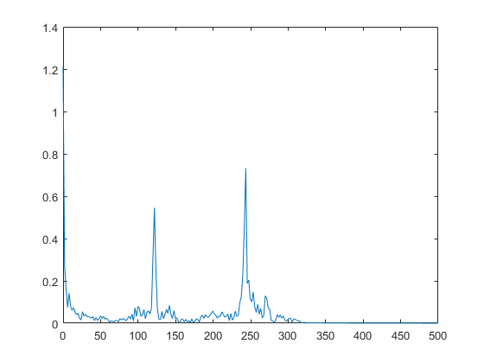
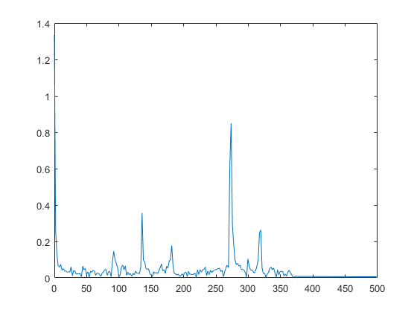
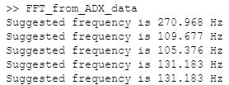
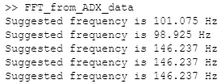
Accelerometer Results Continued (C3,D3)
Using small time windows we can accurately find the frequency played all the down the length of the A string.
131Hz
147Hz
Notes:
‹#›
‹#›
‹#›
‹#›

Slide 11
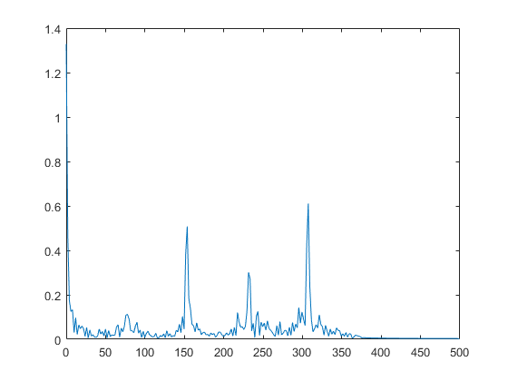
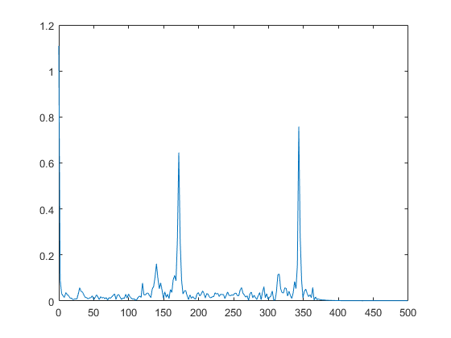
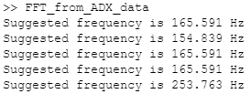
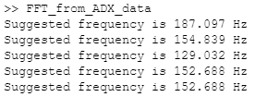
Accelerometer Results Continued (E3,F#3)
Using small time windows we can accurately find the frequency played all the down the length of the A string.
165Hz
185Hz
Notes:
‹#›
‹#›
‹#›
‹#›

Slide 12
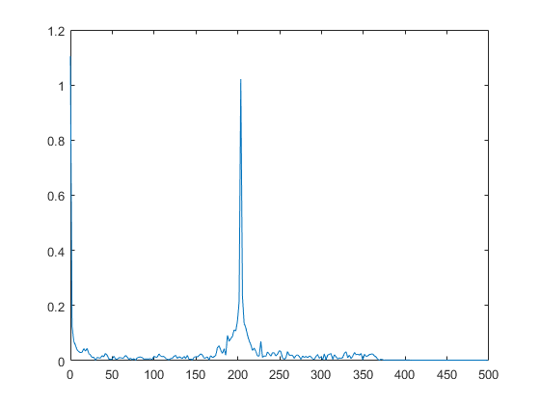
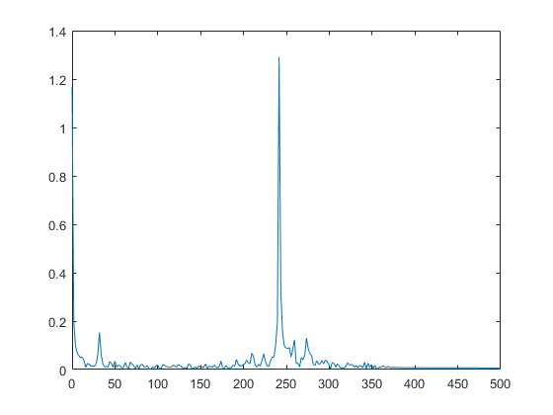
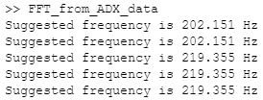
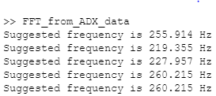
Accelerometer Results Continued (A3,C4)
Using small time windows we can accurately find the frequency played all the down the length of the A string.
220Hz
262Hz
Notes:
‹#›
‹#›
‹#›
‹#›

Slide 13
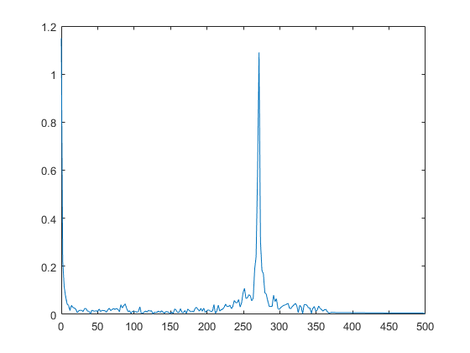
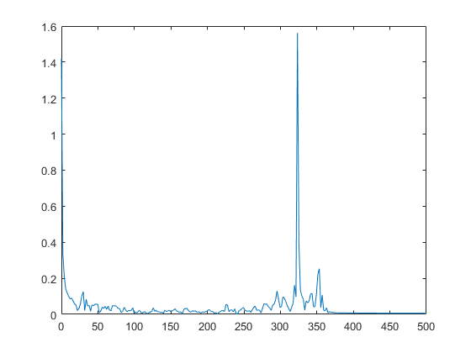
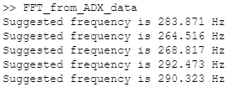
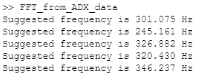
Accelerometer Results Continued (D4,F4)
Using small time windows we can accurately find the frequency played all the down the length of the A string.
294Hz
349Hz
Notes:
‹#›
‹#›
‹#›
‹#›

Slide 14
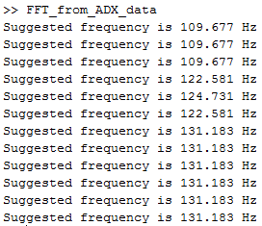
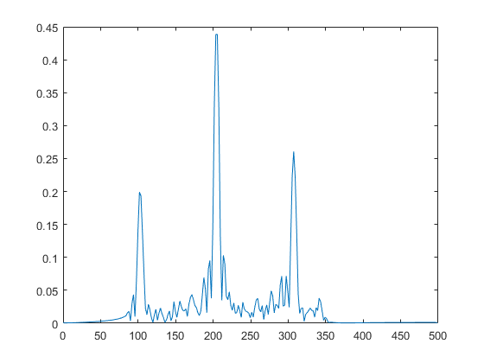
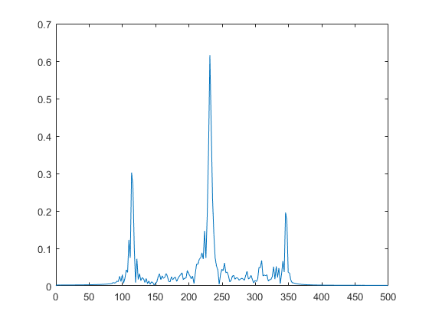
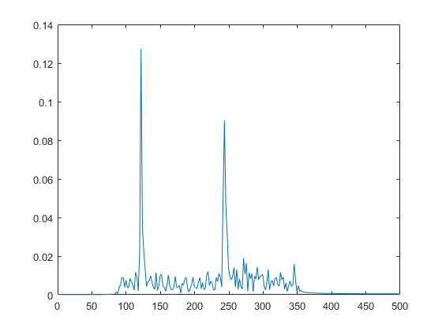
Accelerometer Results: 3 Notes in Succession

Slide 15
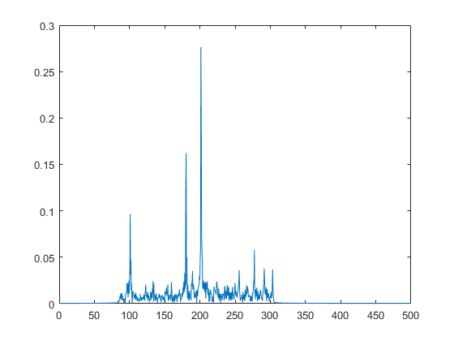
Accelerometer Results: Multiple Notes (A2,G3)

Slide 16
Accelerometer Challenges
Data Sampling
Originally we were using bypass mode on the ADXL345, but realized that we may be losing samples
Switched to FIFO mode which stores the values in buffer
When the data rate of the accelerometer is at 3200 Hz, then the FIFO buffer fills up before values can be read out of it
Higher frequencies and elongated signals were proving more difficult to pick up; probably due to drops in sampling
With low frequencies we will need more data points for our FFT to be accurate, which would cause the time between reading notes to go up
Notes:
‹#›
‹#›
‹#›
‹#›

Slide 17
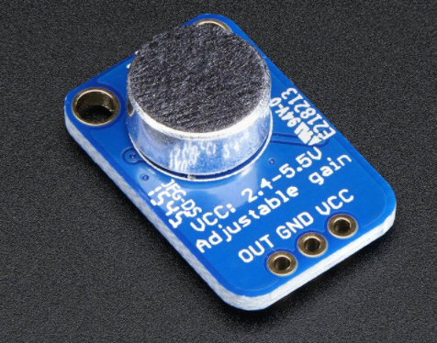
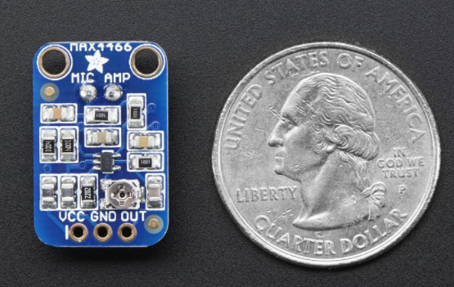
Microphone Features
Max4466 Electret Microphone Amplifier
Fully assembled electric microphone and Max4466 amplifier breakout board.
20Hz - 25kHz microphone range
Analog output to be connected through microcontroller ADC
Adjustable gain
Rail-to-Rail outputs
Notes:
‹#›
‹#›
‹#›
‹#›

Slide 18
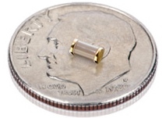
Vibration Sensors
In coordination with the ADXL345, these vibration sensors will allow us to determine the string being played when a frequency is detected
The sensors will be placed as close to the base as possible, providing an analog output when moved and having the smallest dampening effect on the strings as possible

Slide 19
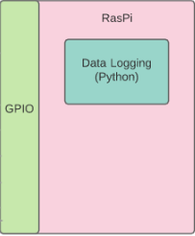
RaspberryPi
Python
Script for collecting data from the ADXL345
The code takes the data samples from the accelerometer and stores them in a file
Using USB, the file can then be transferred to perform MATLAB signal processing
We will use the GPIO on the Raspberry Pi handle button interrupts from the UI
Notes:
‹#›
‹#›
‹#›
‹#›

Slide 20
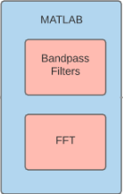
MATLAB
Raw data is read in from the Raspberry Pi
Passed through a Hamming Window BPF with cutoff frequencies of 90 and 300Hz.
The filtered data is sent through a for loop which iterates FFT’s of 500 points spaced 250 points apart.
A series of logical statements is used to locate the peaks in the FFT and determine which one is the correct frequency

Slide 21
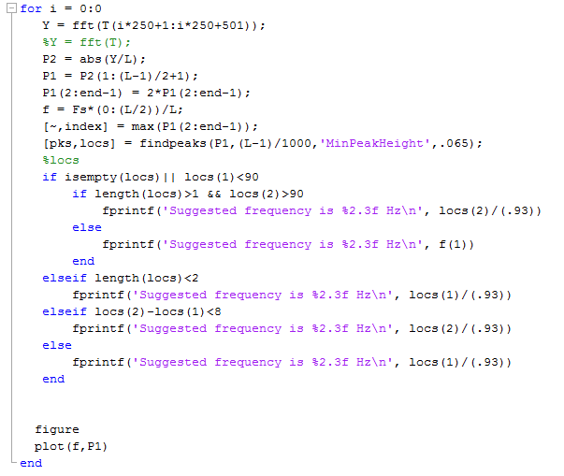
MATLAB Continued

Slide 22
Creating Tablature
Use the detected frequency and string vibration to determine the fret number.
The frequency ratio between two notes is 2^{n/12} . Were n is the number of semitones between the notes
Use the frequency of the open string to determine how many frets (semitones) are ‘between’ the open string and played note
Example: A3 (219.355 Hz)
~ 12
Notes:
‹#›
‹#›
‹#›
‹#›

Slide 23
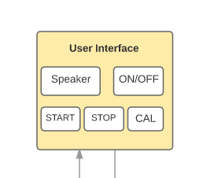
User Interface
Buttons
The four buttons (start, stop, on/off, and calibrate), will each be tied to GPIO to allow the user to record and calibrate his guitar
The calibration function will have the user play an open E string to allow the device to determine the tuning for the rest of the guitar
This allows the user to have any tuning style while recording their music into tablature
A speaker will also be implemented on the PCB for the UI, providing the user audible feedback when pressing buttons

Slide 24
Proposed CDR Deliverables
Data Logging
Data sampling rates will be matched and sample at a rate of greater than or equal to 2.1 KHz
We will accurately record 10 notes played over a 20 second time window
Over that 20 second time window, the correct strings will also be recorded for each note
Signal Processing
Our algorithm will be able to properly identify both the string and fret of the 10 notes
(Optional) Have a BPF Bank
Be able to visually output the frets played over a duration
User Interface
Buttons will be implemented for start/stop functionality
Speaker gives audible feedback on start/stop
A calibrate button will allow the user to verify the correct frequency for each string on their guitar
Preliminary PCB model will be designed in Eagle Software
Vibration sensors will be incorporated into the design
Vibration sensors will be able to identify which string is being played
Based off of these time stamps we will be able to match them with the frequency spikes we see
Notes:
‹#›
‹#›
‹#›
‹#›

Slide 25
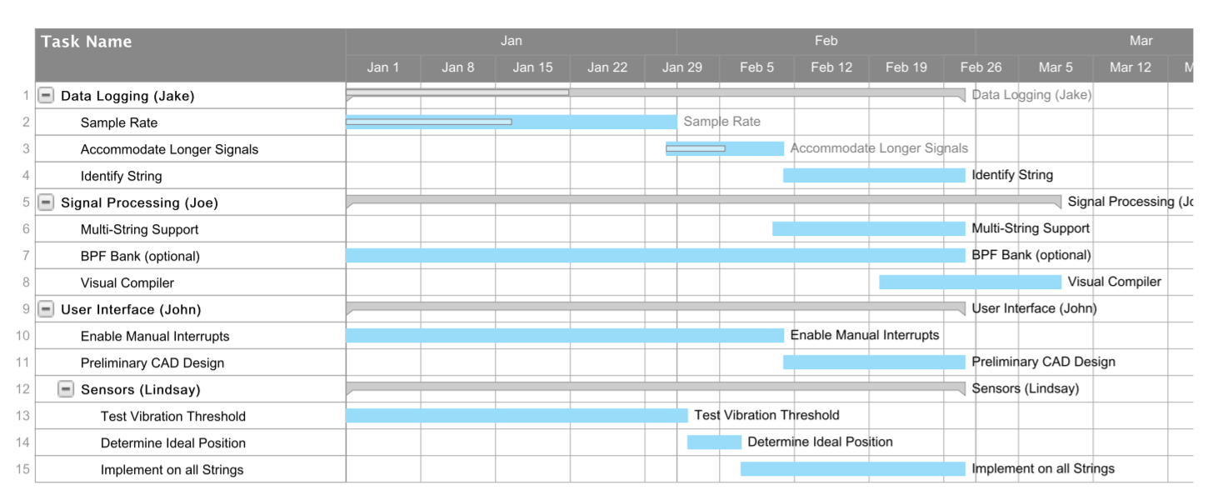
Schedule
Notes:
‹#›
‹#›
‹#›
‹#›

Slide 26
Project Costs
Notes:
‹#›
‹#›
‹#›
‹#›

Slide 27
Thank You
Questions?
Notes:
‹#›
‹#›
‹#›
‹#›

